Slide 1


Slide 2


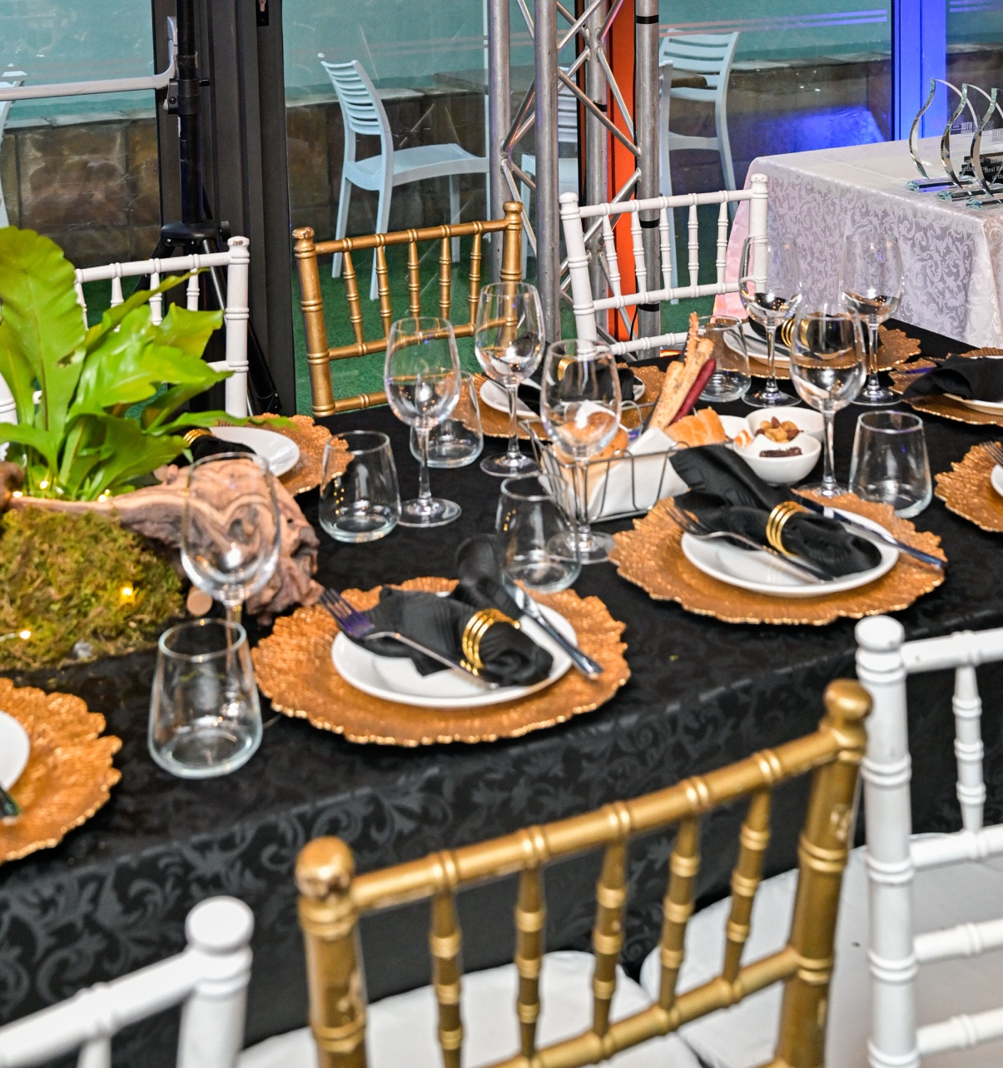

CATEGORIES
Commercial Development of the Year ( 2024-2026 )
Rising Star of the Year (under 35 Years)
Green Champion of the Year ( Person or Brand )
Green Development of the Year ( 2024-2026 )
Residential Development of the Year ( 2024-2026)
Luxury Hospitality Development of the Year ( 2024-2026 )
Mixed Use Development of the Year (2024 - 2026)
Refurbishment of the Year ( 2024-2026)
Hospitality Innovator or Innovation of the Year (person or brand)
Lifetime Achievement Award
Developments must have been completed between 2024 - 2026 to qualify where indicated

Slide 3
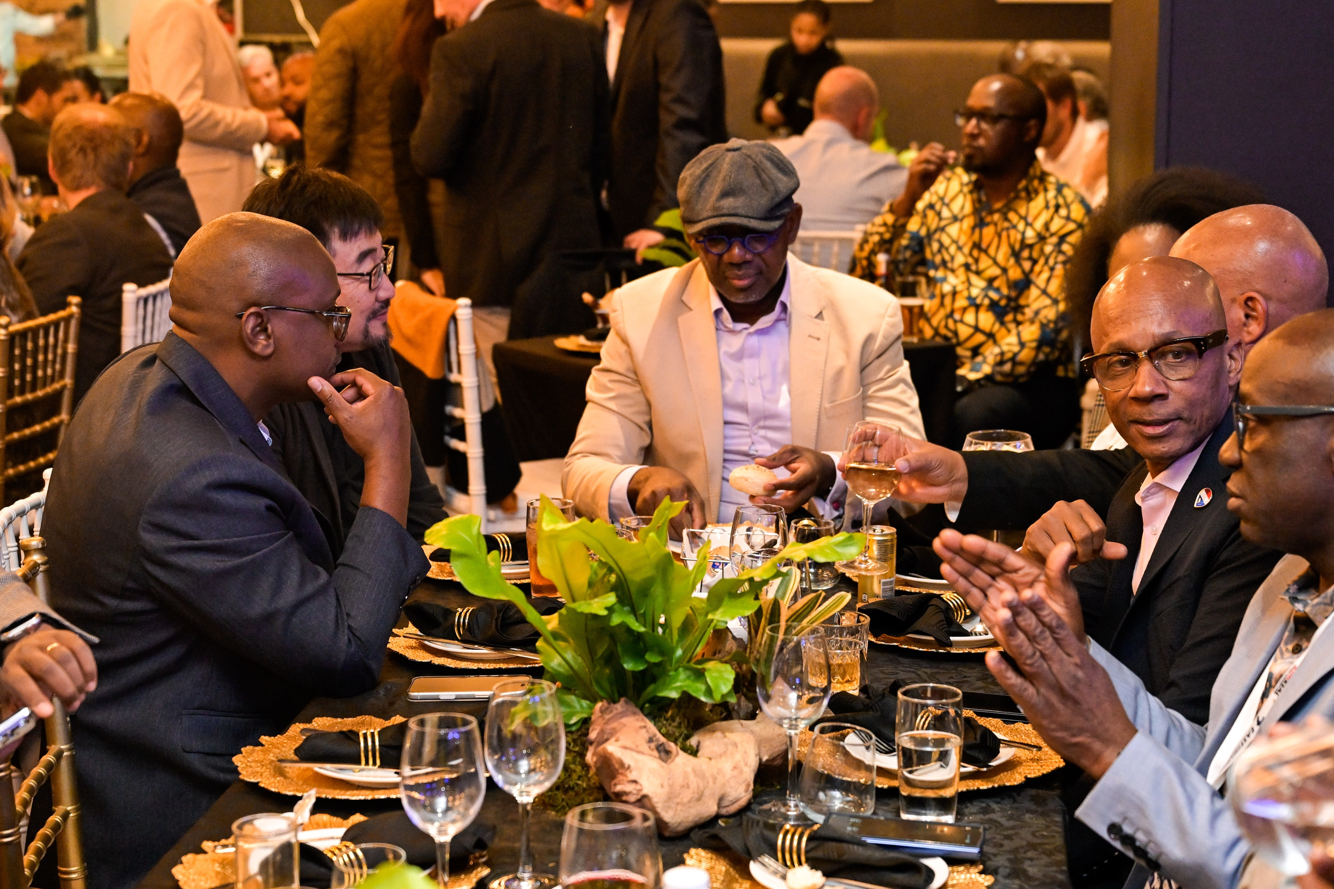
IMPORTANT INFORMATION
Finalists MUST attend Morocco Showcase Summit
All required documents (as seen on page 5) must be completed and submitted by the 10 November 2026.
Entrants/Nominees must operate or have contributed within the Morocco Real Estate and hotel sector.
Applications are open to individuals, teams, companies, operating within or from Morocco
Champions Evening is limited & not all Morocco Showcase Summit Guests are eligible.

Slide 4
BASIC INFORMATION
Name and Surname
Company of the Person Submitting the Award
Email Address
Mobile Contact Number (with country code)
Which Award are you entering for? (Categories on page 2)

Slide 5

PLEASE UPLOAD SUPPORTING DOCUMENTS
1 Page CV - Attach as a PDF / Word Document – If Applicable
200 - 400 Words motivation on why you, company, or your project should be considered a champion in your field.
All certifications and motivations relevant to the awards entered.

Slide 6
Why you, or your project should be considered a champion in each field. (200 - 400 Words)

Slide 7
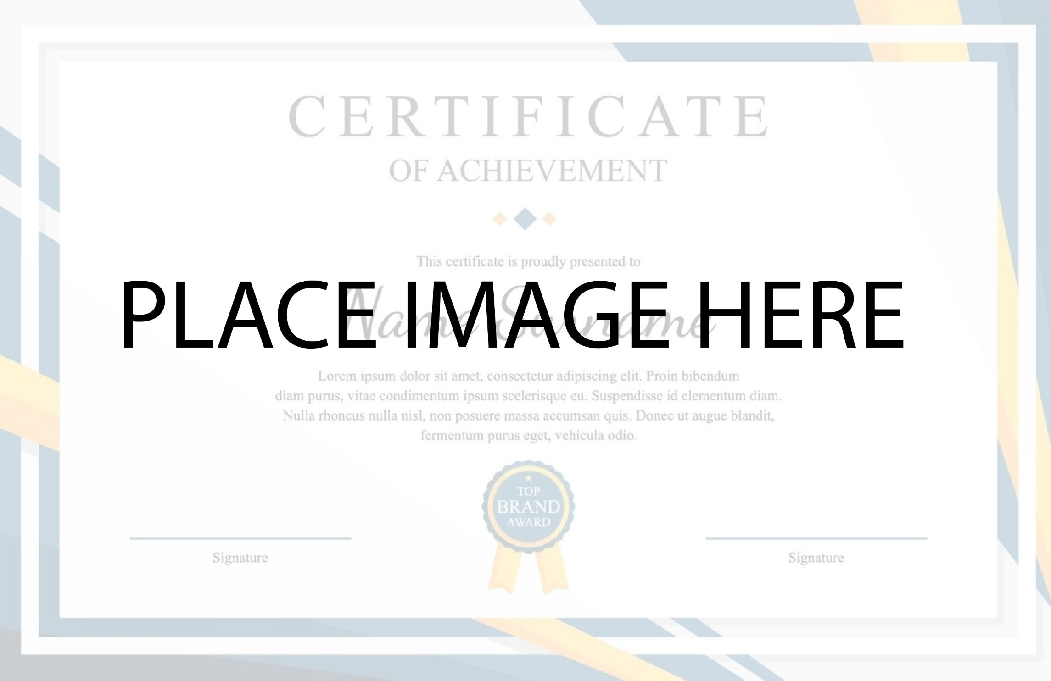
CERTIFICATON
IF NEEDED

